Slide 1
OSCE-I
Emergency

Slide 2
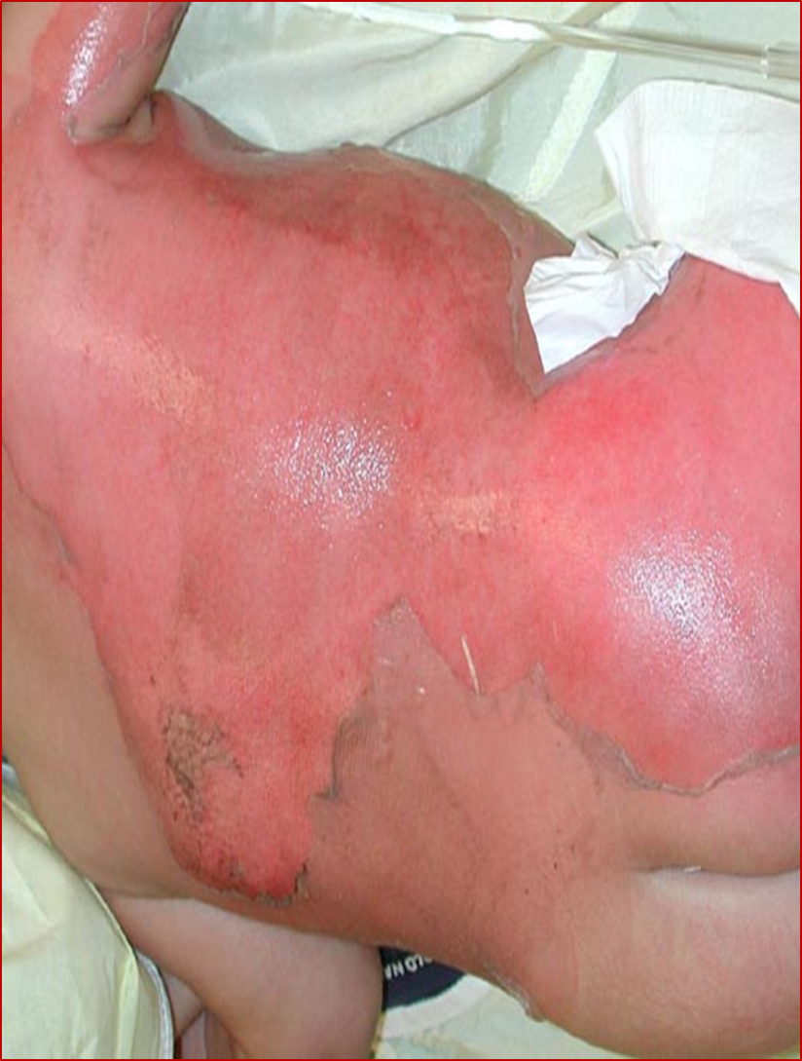
Burn
What do you see?
Differential diagnosis ?
Management ?

Slide 3
Cont’d
What do you see?
DDX
  Burn (thermal, chemical, electrical, radiational)
  SSSS (staphlococcal scalded skin syndrome
  Toxic shock syndrome
  Steven jonson syndrome
  Kwash dermatitis
  cellulits

Slide 4
Burn- mx
Emergency aid
Fluid resuscitation
Prevent hypothermia
Pain management
GI considerations* anti histamine
Antibiotics *not indicated in early post burn
TAT

Slide 5
Criteria for admission
Full-thickness > 5% BSA
Partial-thickness > 10% BSA
Any full-thickness or partial-thickness burn involving critical areas (face, hands, feet, genitals, perineum, skin over major joint)
Children with severe burns
Circumferential burns of thorax or extremities
Significant chemical injury, electrical burns, lightening injury, co-existing major trauma or significant pre-existing medical conditions
Presence of inhalation injury

Slide 6
Burn- mx(2)
Emergency Aid
  ABC of life
  Avoid hypothermia
  Remove constricting clothes
Fluid resucitation
  Vascular access: Two large bore peripheral lines (if possible) or central line.
  4 ml R/L x % burn x body wt. In kg (parkland)
Notes:
RL- because it has lactate to buffer the acidosis in early post burn phase
Fluid requirement calculations for infusion rates are based on the time from injury, not from the time fluid resuscitation is initiated.
There is also Galveston Formula for fluid resuscitation in burn patients

Slide 7
Cont’d
½ of calculated fluid is administered in the first 8 hours
Balance is given over the remaining 16 hours.
Maintain urine output at 0.5 cc/kg/hr.
ARF may result from myoglobinuria
Increased fluid volume, mannitol bolus and NaHCO3 into each liter of LR to alkalinize the urine may be indicated
Notes:
Adequacy of resuscitation is assesed by
Peripheral blood pressure
Urine out put
Central venous pressure *main indicator of ARF
Heart rate *indicate the need for fluid or pain managment

Slide 8
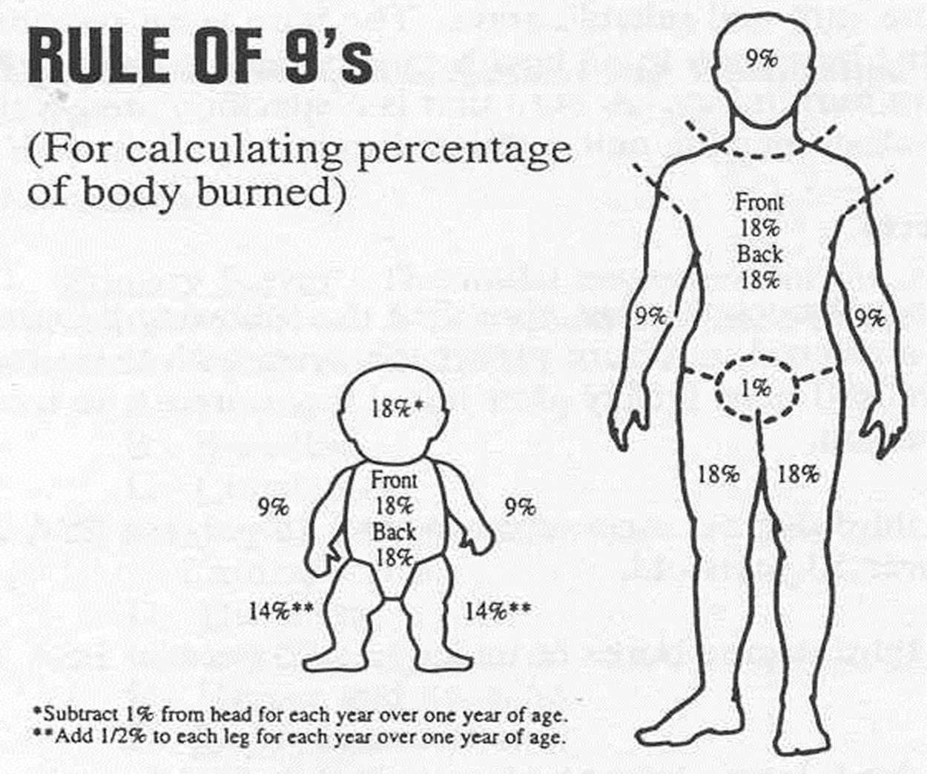
Burn- Ass’t
Its inaccurate in childre

Slide 9
Burn- mx (2)…
3. Prevent hypothermia
Cover patients with a dry sheet – keep head covered
Pre-warm trauma room
Administer warmed IV solutions
Avoid application of saline-soaked dressings
Avoid prolonged irrigation
Remove wet / bloody clothing and sheets
Avoid application of antimicrobial creams
Continual monitoring of core temperature

Slide 10
Cont’d
4. Pain management
5. GI consierations
NGT insertion to reduce potential for aspiration and paralytic ileus.
Early administration of H2 histamine receptor recommended
6. Antibiotics
Prophylactic antibiotics are not indicated in the early postburn period.
7. Other
TAT
Debride and treat
Notes:
Burns > 25% TBSA subject to GI complications secondary to hypovolemia and endocrine responses to injury

Slide 11
other
SSSS
  Cause: s.aures
  Affect infants and children
  Flexural accentuation and mucus membrane is involved
  Mx: clindamycin, penicillin
TSS
  Cause: s.aures, GAS
  Have associated multi organ failure unlike SSSS
  Desquamation of hands, soles.. 1wk after the onset of acute illness
  Mx: clindamyscn

Slide 12
Cont’d
Steven Johnson syndrome
  Cause
    Infections
    Drug induced
    Malignancy related idiopathic
Mx: symptomatic rx
  ABC of life
  Withdrawal of the agent

Slide 13
Childhood Poisoning

Slide 14
Poisoning
Organophosphates and Carbamates
  Most commonly used insecticides
c/f
  smells of Garlic odor and her clothes are soaked with vomit
  Nicotinic effects=MATCH
    Muscle weakness
    Adrenal medulla action
    Tachycardia
    Cramping of the skin
    Hypertension
    Hypoventilation
Muscarinic = DUMBBELS
  Diarrhea/defecation
  Urination
  Miosis
  Bronchospasm
  Bradycardia
  Emesis
  Lacrimation
  Salivation
Notes:
Fasciculations
Tremors
dysrhytmia

Slide 15
OP poisoning- mx
Dx:
  RBC cholinesterase and pseudocholinesterase concentrations can be measured
  Response to atropine & pralidoxime??
Mx:
Supportive
GI decontamination
Dermal deconta.
Anti dote admi.

Slide 16
Cont’d
Supportive
  ABC of life
  Fluid & electrolyte replacement
  Intubation/ ventilation
2. GI decontamination
  Activated charcoal
  lavage
3. Dermal deconta.
  Removal of clothing
  Wash with soap & water
4. Antidote
  Atropine
  Pralidoxime *not recommended in carbamate
Notes:
Atropinization=dry mouth, miosis, bronchodilation, high PR

Slide 17
Hydrocarbon poisoning
Due to ingestion or inhalation of
  Kerosine
  Gasoline
  Lamp oil
  Paint thinners
c/f
  Aspiration pneumonia
    Common manifestation
    Cough; may progress to resp. failure
    Fever and leukocytosis
  Mild CNS depression

Slide 18
HC poisoining- mx
Dx:
  Hx & physical
  Abnormal CXR
Mx:
  ABC of life
  Oxygen
    Mechanical ventilation and ECMO
  Fluid and Electrolyte mx
  β-blockers (usually esmolol)
  Emesis & lavage are contraindicated
  Activated charcoal- not useful

Slide 19
Ethanol poisoning
A history of ingestion from the caregiver or patient and characteristic physical findings, such as sickly sweet breath odor, altered mental status, and nystagmus with lateral gaze typically are sufficient to establish the diagnosis of ethanol intoxication. Detection of ethanol on the breath or in the serum provides additional confirmation.

Slide 20
Cont’d
c/f:
  exhilaration
  loss of inhibition, which progresses to lack of coordination, ataxia, slurred speech, gait disturbances, drowsiness, and, ultimately, stupor and coma.
  Mild to moderate metabolic acidosis
  Hypothermia, bradycardia, hypotension, resp. distress
  Irritation of GI mucosa
  Inhibition of antidiuretic hormone action in the kidney

Slide 21
Ethanol poisoning- mx
Ix:
  RBS
  Etahnol level
  other ivestigations for child abuse, sexual abuse or trauma
Mx:
  Supportive
  naloxone 2 mg IV push is indicated to rule out opiate toxicity * if no response to supportive
Gastric decontamination
  usually not needed unless child is comatose
  Done in 1hr of ingestion
4. hemodialysis
  increases ethanol clearance by 3 to 4 times indicated with ethanol levels >500 mg/dL or hepatic dysfunction
Notes:
Supportive: ABC.. Fluid+ dextrose, thiamine

Slide 22
Caustic poisoning
Alkali burns
  Liquifactive necrosis
  Has deeper penetration
  Due to ingestion of detergents, battery cell
  cause perioral, oropharyngeal, and upper esophageal injury
Acid burns
  coagulative necrosis
  Eschar formn. Avoids deerper penetartion
  cause severe gastric injury, including perforation

Slide 23
Cont’d
c/f:
  highly alkaline laundry detergents, can cause life-threatening airway edema
  excessive crying
  Drooling
  refusal to eat or drink
Mx:
  ABC of life
  Diluents
  Steroids
    decrease the incidence of esophageal strictures in patients with severe burns
Notes:
Induction of emesis in caustic ingestions is contraindicated.
Lethal acids should be removed through a soft catheter if the patient is seen within 90 minutes of ingestion

Slide 24
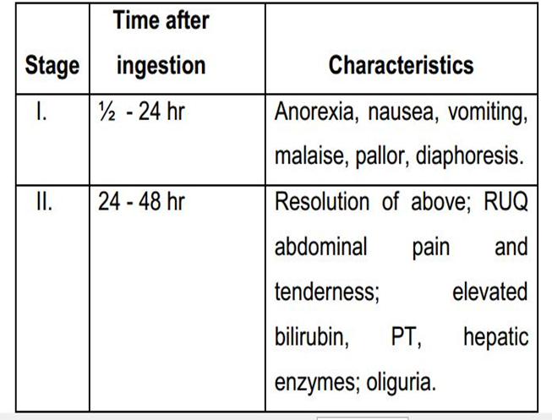
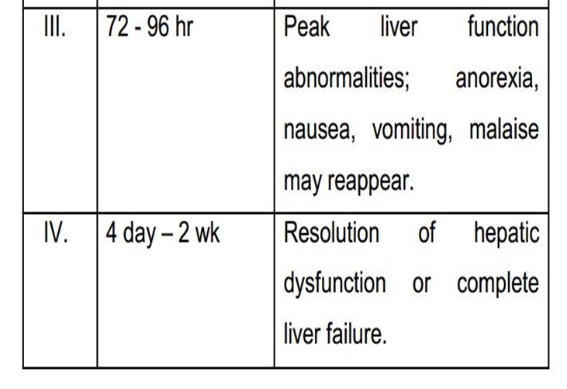
IX:
  plasma level after 4hr
  LFT and enzymes
  Mx:
    activated charcoal
    Antidote: N actyl cystin
Acetaminophen poisoning
  c/f :

Slide 25
Cont’d
Salicylates
  c/f
    Nausea, vomiting
    DHN, met acidosis
    agitation, confusion
    Coma
    Pulm. Edema
    hypoglycemia
  Ix: sr level
    Urine PH
    RBS
    Electrolytes
    LFT
  mx:
    rehydration & correct electrolyte abn.
    Activated charcoal
    Alkalization of urine via IV bicarbonates
    Hemodialysis if sever
Notes:
Salicylates eg. Asprin, diclo, ibuprofen

Slide 26
CO poisoning
c/f: depend on the measured carboxy Hb level
10-20% headache, dyspnea on exertion
20-30% severe headache, nausea
30-40%severe head ache, dyspnea, impaired judgement
50-60% confusion, syncope, seizure
>70% coma, carioresp. distress, death
Dx
  Carboxy Hb level
  CXR 30% abnormal
  ECG
Mx
  Supportive
  100% oxygen by mask
  Hyperbaric oxygen therapy

Slide 27
Management of drowning
ABC of life
Remove wet clothing
Administer warmed and humidified 100% oxygen
Monitor core temperature, heart and respiratory rates, and blood pressure continuously
Consider central venous pressure determination for severe hypothermia

Slide 28
ETAT

Slide 29
Triage Categories
All sick children are rapidly examined on arrival and sorted into 3 categories:
EMERGENCY signs – who require immediate emergency treatment
PRIORITY signs – who should be given priority in the queue, rapidly assessed and treated without delay
NON-URGENT cases – who can wait their turn in the queue. The majority of children seen will be non-urgent cases.

Slide 30
Emergency signs are sorted in order of priority as:
  A = Airway
  B = Breathing
  C = Circulation, Coma, Convulsions
  D = Dehydration
  O= Others (bleeding child, trauma with open fracture, Acute poisoning and Exposing the child after poly trauma also is an emergency assessment)
Priority signs – 3 TPR MOB
  Tiny baby
  Temperature
  Trauma
  Pallor
  Poisoning
  Pain
  Restless
  Respiratory distress
  Referral
  Malnutrition/ marasmus
  Oedema
  Burns
Notes:
Any sign in the ABCDO is classified as an ‘E’ sign

Slide 31
Cont’d
Non-urgent
  Once assessment is complete if no emergency or priority signs are found the child is classed ‘non-urgent’ and should wait their turn in the queue

Slide 32
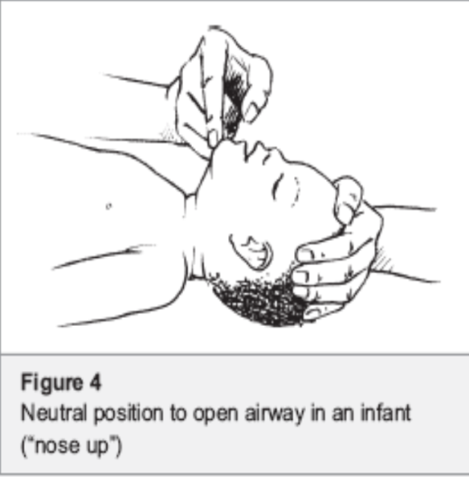
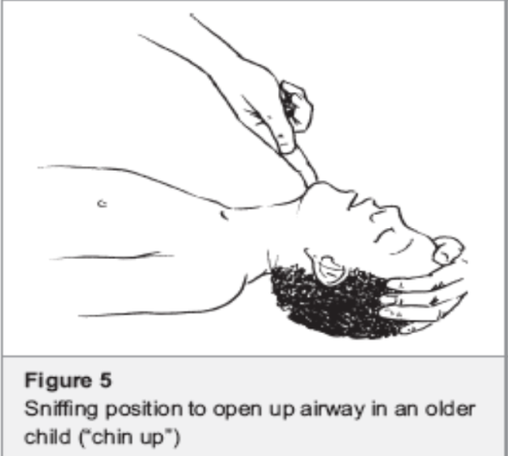
Airway and Breathing
Is the child breathing?
Is the breathing obstructed?
  Tongue flopping back
  Foreign body
  Croup
  Anaphylaxis
history of choking
chin lift with head tilted to appropriate position
Airway positions
  Infant <12 months – NEUTRAL (nose up)
  Child >12 months – SNIFFING (chin up)

Slide 33
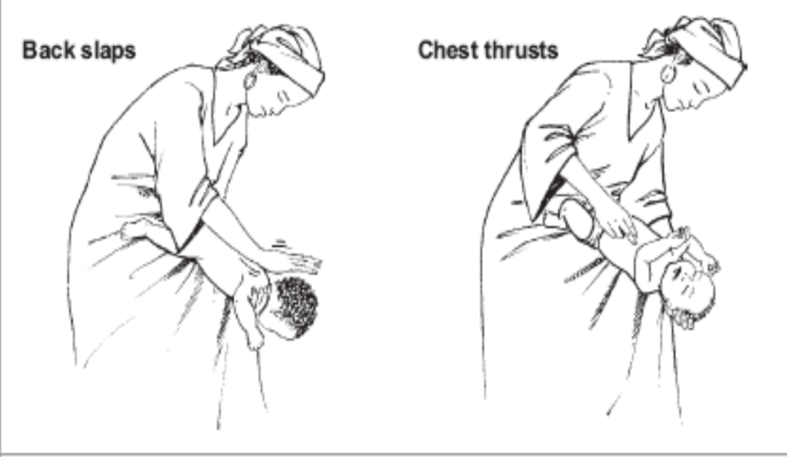
Management of the choking infant
Lay infant on your arm in head down position
Give 5 blows to the infants back with heel of hand
If obstruction persists turn over and give 5 chest thrusts with 2 fingers, 1 finger breadth below nipple level in midline
If obstruction persists check infants mouth
If necessary repeat sequence with back slaps again

Slide 34
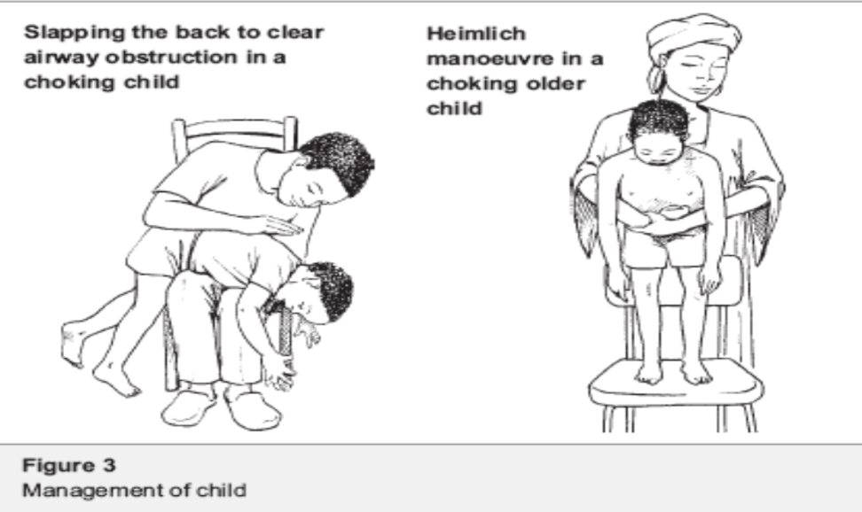
Management of Choking Child
Give 5 blows to the child’s back with heel of hand with child sitting, kneeling or lying
If obstruction persists, go behind the child and pass your arms around the child’s body: form a fist with one had immediately below the child’s sternum; place the other hand over the fist and pull upwards into the abdomen; repeat this Heimlich manoeuvre 5 times
If the obstruction persists, check the child’s mouth
If necessary repeat sequence with back slaps again

Slide 35
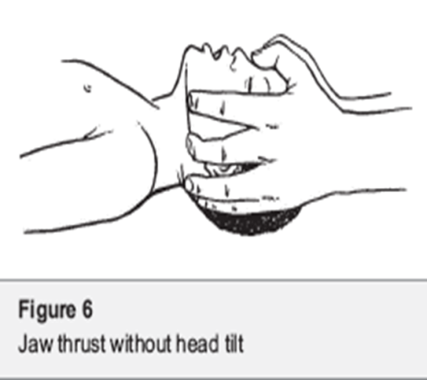
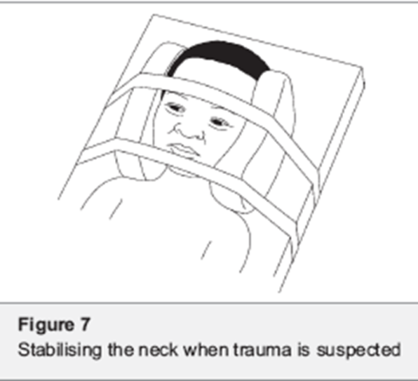
Management of Airway in suspected head/neck trauma
Avoid moving the head or neck
Use JAW THRUST to open airway
Stabilise the neck
Keep lying on back with neck stabilised
Tape forehead to sides of a firm board to secure position
Support head on either side to prevent movement
Place strap over chin
If vomiting turn on side keeping head in line with body (LOG ROLL)

Slide 36
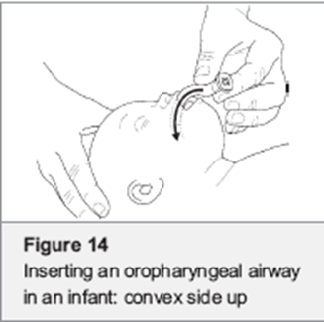
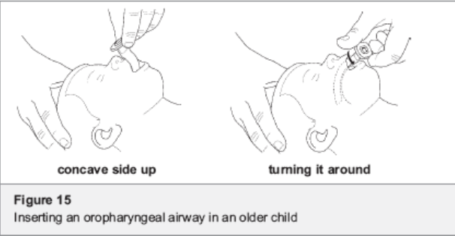
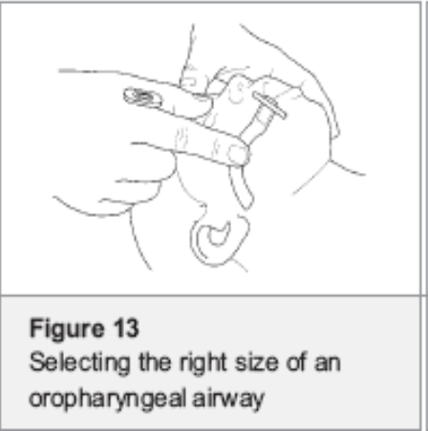
Insertion of an oropharyngeal (Guedel) Airway
Can be used in unconscious patient to improve airway opening
Not tolerated in patients who are awake (gag reflex)
Infants– insert convex side (right way) up
Children- insert concave side up (upside down) then turn
Give Oxygen

Slide 37
Assessment of Breathing
Is the child breathing?
LOOK
  Active, talking, crying = breathing
  Chest moving?
LISTEN
  Listen for breath sounds
  Are they normal or is breathing noisy/ obstructed?
FEEL
  Can you feel breath at the nose/ mouth of the child
Signs of severe respiratory distress
  Very fast breathing
  Severe chest wall indrawing
  Using accessory muscles/ head bobbing
  Stridor
  grunting

Slide 38
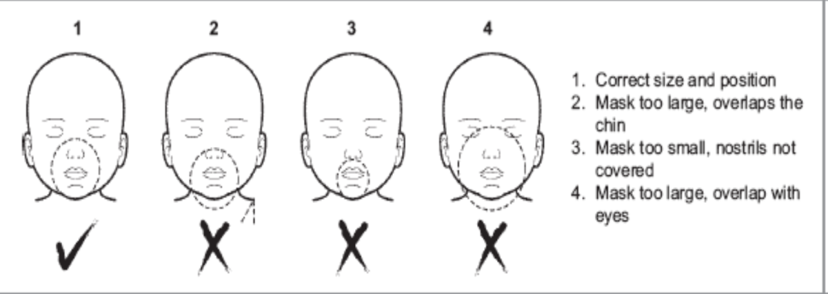
Management of Breathing Problems
Ventilate with Bag and Mask
Consider Oro-pharyngeal (Guedel) airway
Give oxygen
Bag and mask
child who is not breathing or is gasping
Check bag is in good working
Choose correct mask size
Ensure good seal around mouth/nose and open airway
Squeeze bag slowly and evenly
Watch chest rise and allow to fall before giving next breath

Slide 39
Cont’d
Sources of oxygen
  Oxygen concentrator
  Oxygen cylinders
Delivery of oxygen
  Nasal prongs
  Nasal catheter
  Face Mask
Flow rates
  Infant – 0.5-1litres/min
  Child – 1-2 liters/min
  Use flow rate of 5-10 lits/min for Face Mask
Nasal prongs
  Keep clear of mucus
  Secure with tape
  Use correct size or cut to fit
Nasal catheter
  6-8 FG tubing
  Insert to a distance= to nostril to inner eyebrow
  Should not be visible below uvula
  Avoid in pertussis or croup

Slide 40
Circulation
Does the child have warm hands?
If not, is the capillary refill time longer than 3 seconds?
And is the pulse weak and fast?
  Check the radial pulse
  In infants brachial or femoral pulse may be easier
  In older children carotid pulse may be felt
If the pulse is weak and fast the child needs treatment for shock

Slide 41
Management of Shock
A child with cold hands, Cap. refill >3 secs, fast, weak pulse is in shock
Stop any bleeding
  apply firm direct pressure, do not use tourniquet
Give oxygen
Make sure the child is warm
Establish IV or intraosseous access
Take blood samples for emergency lab tests
Give fluids
IV/IO access
Give 20ml/kg Ringer’s lactate or normal saline as fast as possible
Reassess circulation
?No improvement
  Repeat 20ml/s kg Ringers/Saline
  Reassess
?No improvement
  Repeat 20ml/s kg Ringers/Saline
  Reassess
?No improvement
  Give 20ml/kg blood over 30 mins OR
  In severe diarrhoea repeat Ringers
  Reassess
?No improvement
  Treat underlying condition
Notes:
Correct hypoglycemia and hypocalcemia
Give antibiotic if indicated
Epinephine for anaphylaxis

Slide 42
Management of shock in children WITH severe malnutrition
Weigh the child
IV fluid(Ringer/Ns with 5%glucose) 15ml/kg over 1hr
Check pulse and breathing rate every 5-10mins
Stop IV infusion if either of these; increase
  pulse by 15,
  RR by 5
If there is improvement (pulse and breathing rate fall)
  Repeat 15ml/kg over 1 hour
  Switch to oral or NG ReSoMal 10ml/kg/h
If there is NO improvement
  Call senior health worker
  Give maintenance IV fluid 4ml/kg /h while waiting for blood
  Transfuse fresh whole blood at 10ml/kg/h slowly over 3 hours (use packed red cells if cardiac failure)

Slide 43
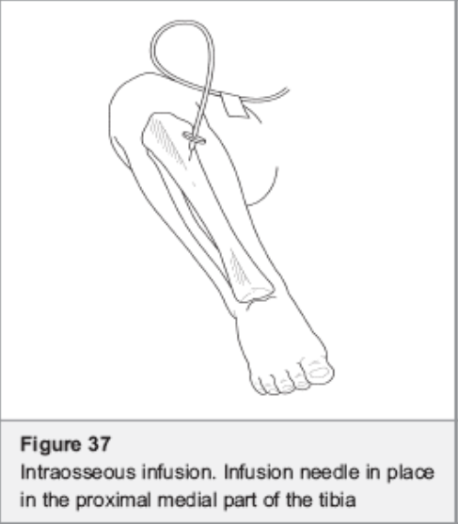
Intravenous Access
Use if IV access impossible
Avoid if:
  Infection at puncture site
  Fracture of the bone
Site:
  Proximal tibia1-2cm below and medial to the tibial tuberosity
  Alternative – distal femur, 2cm above lateral condyle
Can use special needle or large needle (21g) +syringe
Should be removed after 8 hours or as soon as IV access obtained
Notes:
NB,IV canula FG24/22 can be used instead of butter fly needle. If it is available and it can be used untill IV access with IV canula is secured

Slide 44
Coma and Convulsion
A –Is the child ALERT? If not,
V –Does the child respond to Voice? If not,
P –Does the child respond to Pain?
U – Child who is Unresponsive to Voice and Pain is Unconscious
Any child with a coma score of ‘P’ or ‘U’ needs emergency treatment for coma
Level of consciousness can also be assessed by GCS (for follow up of the child progress)

Slide 45
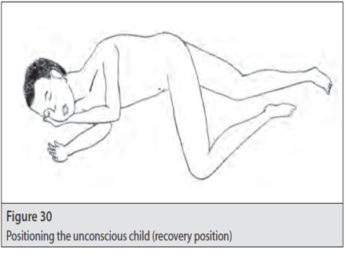
Management of Coma and Convulsion
Airway
  Keep open
  Do not insert anything into mouth of convulsing child
Position
  Recovery position – turned to side, hand supporting head, bent lower leg maintains position
  If spinal injury suspected stabilise on back, log roll if vomiting
Check blood sugar
  Dextrostix or glucometer
If glucose <45mg/dl ( or 54mg/dl in a malnourished child) give dextrose
  5ml/kg 10% dextrose
Recheck glucose after 30 mins – if still low repeat
Feed as soon as conscious

Slide 46
Management of Convulsion
If child convulsing Now give:
  PR Diazepam 0.1ml/kg (10mg/2ml solution)
  Or IV Diazepam 0.05ml/kg
NB Do not give Diazepam IM!
If still convulsing after 10 mins repeat diazepam (PR or IV). After the 3rd dose give:
Phenytoin20mg/kg IO/IV over 20min(monitor for Arrhythmia)
Phenobarbitone 15-20mg/kg IV or IM(for neonates)
Reduce fever if present with tepid sponging

Slide 47
Management of status epileptics
causes
CNS infections
Acute hypoxic ischemic insult
Metabolic disease (eg, hypoglycemia, inborn error of metabolism)
Electrolyte imbalance
Traumatic brain injury
Drugs, intoxication, poisoning
Cerebrovascular event
Definition
  continuous seizure activity or recurrent seizure activity without regaining of consciousness lasting for more than 5 min

Slide 48
Cont’d
Principles of management
  Treat life threatening conditions
  Treat the acute seizure
  Treat the underlying cause
  Prevent recurrence
  Prevent and treat systemic complications
ABC…of life
Diazepam Iv or rectal
Phenytoin /fusphenytoin iv
  Loading dose 20mg/kg
  Reload with 10mg/kg
Phenobarbital lv/po loading dose 20 mg/kg
  Realod 10 mg /kg
Midazolam dripe
Propofone Thoipental ,pentobarbital

Slide 49
Febrile seizure
Occur B/n age of 6 and 60 mo
With a Tº of ≥38°C (100.4°F) ,
Are not the result of CNS infection or any metabolic imbalance
Occur in the absence of a history of prior afebrile seizures.
Febrile status epilepticus is a febrile seizure lasting longer than 30 min.

Slide 50
Dehydration
NO severe malnutrition
  Give Ringer’s Lactate
  Infants:
    30mls/kg over 1 hour
    70mls.kg over next 5 hours
  Children >1 year:
    30mls/kg over 30min then
    70mls/kg over2½ hours
  Assess child every 1-2 h
  If not improving:
    Give fluid more rapidly
    Inform senior staff
  As soon as child can drink
    Give ORS 5ml/kg/h
WITH severe malnutrition
  Do not give IV fluids
  Give resomal 5ml/kg every 30 mins for first 2 hours
  Then 5-10mls/kg for the next 4-10 hours
  Give more resomal if child wants more or large stool loss or vomiting
  Check blood glucose and treat if <3mmol/l
  Treat malnutrition as per guidelines

Slide 51
Cardiopulmonary Resuscitation
Step 1
  ABCs are priority
  Check patient responsiveness attempt to rouse the patient with verbal or painful stimuli
  If no response, assume that the brain is no longer receiving adequate oxygen
Step 2: Assessment and Management of airway
  assess for a patent airway, use
  look/listen/feel approach
Notes:
Unlike adults cardiac arrest is more often caused by progression of respiratory failure, or shock than by primary cardiac arrhythmias

Slide 52
Cont’d
Step 3: Giving rescue breaths
  If the child is not breathing give two breath with a bag mask device or mouth-to-barrier with observing chest rise
  After two breaths are delivered, assess for a central pulse for 10 sec
Step 4: Chest compressions
  palpate the xiphoid process and place hands directly above this area .
  In older children, place one hand on top of the other In younger children (<8 years) only 1 hand In infants, use 2 fingers in the center of the chest just below the Nipples
Notes:
Central pulse means carotid pulse in older or femoral or bracheal for small child

Slide 53
Cont’d
Push the chest, making sure to keep your shoulders directly over the child’s chest , push down onto your hands and elbows remain locked
push fast (rate of 100/min)
push hard (about 1/3 to 1/2 of AP chest diameter)
Allow for full chest recoil in between compression and
Minimize interruptions
Rotate rescuers ever 2 minutes or sooner when tired

Slide 54
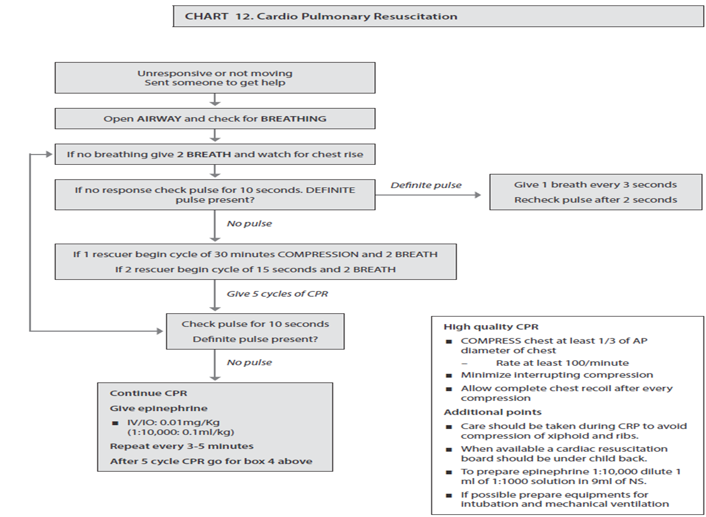

Slide 55
Pediatric Trauma
Primary survey and Resuscitation
  Airway maintenance with cervical spine protection
  Breathing and ventilation
  Circulation with hemorrhage control
  Disability (evaluation of neurologic status)
  Other/Exposure and environmental control
Adjuncts to primary survey
  Consider laboratory – Hct/Hgb, blood group and Rh, random blood sugar
  Urinary catheter ;NG tube
  If ultrasound is available, consider performing FAST u/s
  have controlled PAIN

Slide 56
Secondary survey
History (SAMPLE )
SAMPLE history
S- sign and symptom
A - Allergies ? Pencilline
M - Medications ? Epileptic, ? Diabetic, asthmatic
P - past medical and surgical history
L - Time of the child's last meal , helps for OR
E - Events preceding the accident Get a good HISTORY
Complete head to toe evaluation including
laboratory studies
Radiographic studies

Slide 57
Pneumothorax

Slide 58
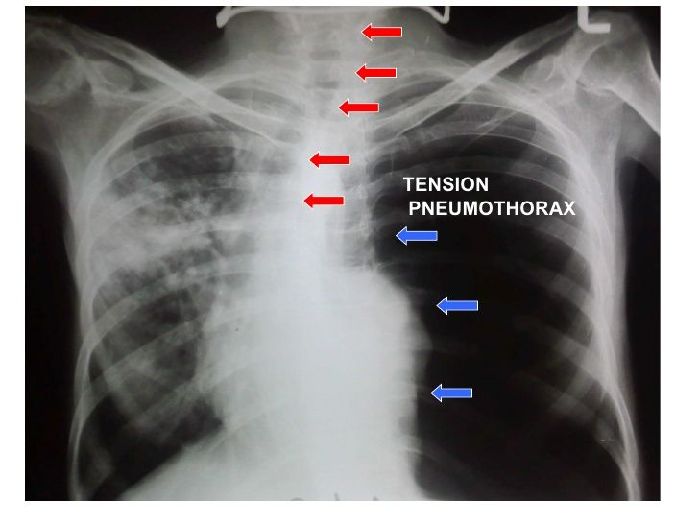
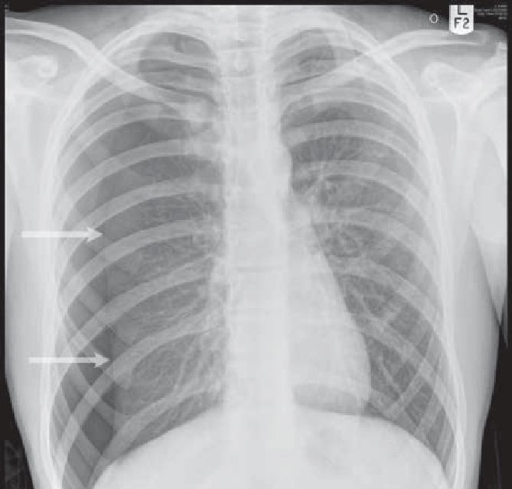
What do you see?
Differential diagnosis?
Management?

Slide 59
Cont’d
What do you see?
  Collapse of the lungs on the affected side
  Absence of lung marking
  Wide intercoastal space
  If tension pneumothorax
    Tracheal shift
    Mediastinal shift
Differntal
  Chest trauma
Notes:
CF: distended neck vein, low BP, low sat of O2, tachycardia
chest is hyperresonanat, distended neck veins

Slide 60
Cont’d
Mx
Needle decompression in the second intercostal space mid clavicular line
Chest tube* defnitive mx
Open pneumothorax
  Three way dressing
  Chest tube at different site

